Slide 1
Genetic Improvement using Higher Order Mutation
Yue Jia, Fan Wu, Mark Harman and Jens Krinke

Slide 2
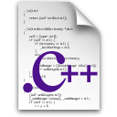

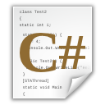

Genetic Modifications
Evolve an entire program
Evolve a sequence of edits
Finely control
the code generation
Coarse level
of genetic modifications
Small to medium sized system
Large real world systems

Slide 3


Genetic Modifications
Higher Order Mutants
Modifications based on a set of mutation operators
HOMT is flexible and provides a finer level of control in the code generation

Slide 4
Higher Order Mutation GI
GI Mutants
1
2
3
Original Source
First order mutation
GI Higher order mutation
Mutation based Test data generation
Mutant Report
1
Sensitivity Analysis*
2
Multi-objective Search
3
Faithfulness Analysis
* Wednesday, SBSE-SS3

Slide 5

Discussions
Do mutation operators provide a generic and scalable way to modify programs?
Is mutation-based test data generation sufficient for faithfulness analysis?

