Slide 1


Evolutionary Approximation of Software for Embedded
Systems: Median Function
Vojtech Mrazek, Zdenek Vasicek, Lukas Sekanina
Faculty of Information Technology
Brno University of Technology,
Czech Republic
Notes:
25

Slide 2
Outline
Approximate computing
Median function
  properties, implementation, application in image processing
Evolutionary approximation of median function
  the proposed method
  analysis of the results for real microcontrollers

Slide 3
Approximate computing
Motivation: many real-world applications are error-resilient
Principle: relaxation in accuracy can be used to simplify the complexity of computations and reduce the power consumption
Applicability: 83% of runtime spent in computations can be approximated
V. K. Chippa, S. T. Chakradhar, K. Roy and A. Raghunathan, Analysis and characterization of inherent application resilience for approximate computing, DAC 2013.
error
acceptable
error
approximate computing
initial solution
genetic improvement
power consumption
Notes:
Nejprve - introduce the approximate
There is an explosive growth in digital information content. Moreover, there is also a rapid increase in the number of users of multimedia applications related to image and video processing, recognition, mining and synthesis.
Approx pocitani je podobny smer jako GI, nektere aplikace jsou vsak error-resilient. Cilem navrhu je vetsinou ziskat energy efficient system
GI umi zlepsit vychozi implementaci bez vytvoreni chyby,
V nekterych aplikacich mame urcitou chybu povolenou
Approximate computing zlepsi mnohem vic cilovy program s tim ze udrzi rozumnou chybu

Slide 4
Median function
Median: a value separating a finite sequence of data samples to two halves
Typical application: smoothing of acquired (measured) data
Example: noise removal in an image using a concept of sliding window
median
Input (corrupted) image
Output (filtered) image
Notes:
Image processing example

Slide 5


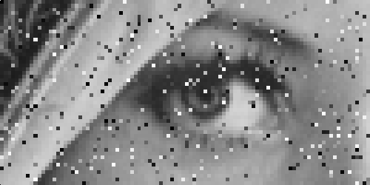
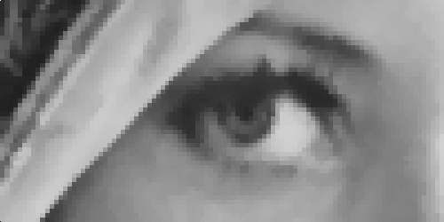

Median in image processing
corrupted image
(10% pixels, impulse noise)
filtered image
(9-input median filter)
original

Slide 6
Implementation of median filter
To determine the median, we can employ:
  a sorting algorithm
  a selection algorithm
  a median network
Median network
  a structure consisting of compare & swap operations
  an optimal network is known for some sizes
#define PIX_SORT(a,b) {
if ((a)>(b))
PIX_SWAP((a),(b));
}
pixelvalue opt_med9 (pixelvalue * p)
{
PIX_SORT(p[1], p[2]) ; PIX_SORT(p[4], p[5]) ; PIX_SORT(p[7], p[8]) ;
PIX_SORT(p[0], p[1]) ; PIX_SORT(p[3], p[4]) ; PIX_SORT(p[6], p[7]) ;
PIX_SORT(p[1], p[2]) ; PIX_SORT(p[4], p[5]) ; PIX_SORT(p[7], p[8]) ;
PIX_SORT(p[0], p[3]) ; PIX_SORT(p[5], p[8]) ; PIX_SORT(p[4], p[7]) ;
PIX_SORT(p[3], p[6]) ; PIX_SORT(p[1], p[4]) ; PIX_SORT(p[2], p[5]) ;
PIX_SORT(p[4], p[7]) ; PIX_SORT(p[4], p[2]) ; PIX_SORT(p[6], p[4]) ;
PIX_SORT(p[4], p[2]) ; return(p[4]) ;
}
Source: http://ndevilla.free.fr/median/median.pdf
Notes:
How to design it?
a sequence of caS instructions that manipulates with the input sequence
http://ndevilla.free.fr/median/median/src/optmed.c - in theory, cannot go faster without assumptions on the signal.
http://ndevilla.free.fr/median/median.pdf
Median filtering is a commonly used technique in signal processing. Typically used on signals that may contain outliers skewing the usual statistical estimators, it is usually considered too expensive to be implemented in real-time or CPU-intensive applications.

Slide 7
Implementation of median filter
Alternatively, max and min operations can be used
  the sequence of operations is invariant w.r.t. the input data
  suitable for HW architectures equipped with MIN/MAX instruction
  easier evaluation of the correctess (zero-one theorem, AND/OR)
pixelvalue approx_med9 (pixelvalue * p)
{
pixelvalue s00=MIN(p[2],p[3]), s01=MAX(p[5],p[4]), s02=MAX(p[2],p[3]);
pixelvalue s03=MIN(p[4],p[5]), s04=MIN(p[0],p[1]), s05=MAX(p[7],p[6]);
pixelvalue s06=MIN(p[8],s05) , s07=MAX(p[0],p[1]), s08=MAX(s04,s00) ;
pixelvalue s09=MAX(s08,s03) , s10=MIN(p[6],p[7]), s12=MIN(s01,s07) ;
pixelvalue s13=MIN(s12,s02) , s14=MAX(s06,s09) , s15=MIN(s06,s09) ;
pixelvalue s16=MAX(s13,s15) , s17=MAX(s10,s16) , s18=MIN(s14,s17) ;
return s18;
}
Approximate median – 18 operations
Notes:
Nahrazeni – vyhodne pro CPU, ktery ma tyto operace (odpadne vetveni);
dale je to vhodne evoluci, nebot MIN/MAX lze realizovat pomoci hradel AND/OR
konec: a cilem evoluce bude hledat takovy program; zbyva jen rici, zda-li ma smysl aproximovat

Slide 8



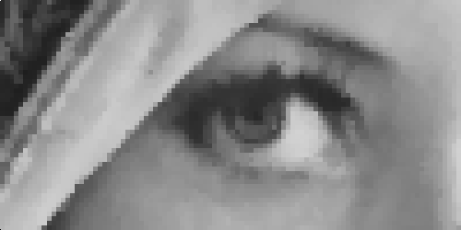
Approximate median filter
filtered image
(9-input median filter – 6 instructions)
filtered image
(9-input median filter – 18 instructions)
6 instructions
18 instructions
38 instructions

Slide 9
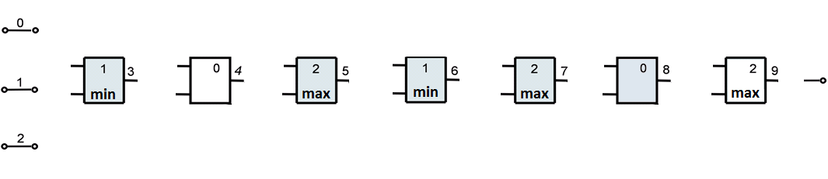
Approximate circuit design by means of CGP
Median network (consisting of up to N operations) is represented by means of an one-dimensional array of N nodes.
Each node can act as: identity (0), minimum (1), maximum (2)
Each node can be connected to a node situated in the previous columns (no feedbacks are allowed).
The configuration of nodes (the function and connection) is encoded using 3N + 1 integers.
Chromosome: 0, 2, 3; 3, 2, 0; 0, 2, 2; 5, 3, 1; 6, 1, 2; 7, 0, 0; 6, 8, 2; 8

Slide 10
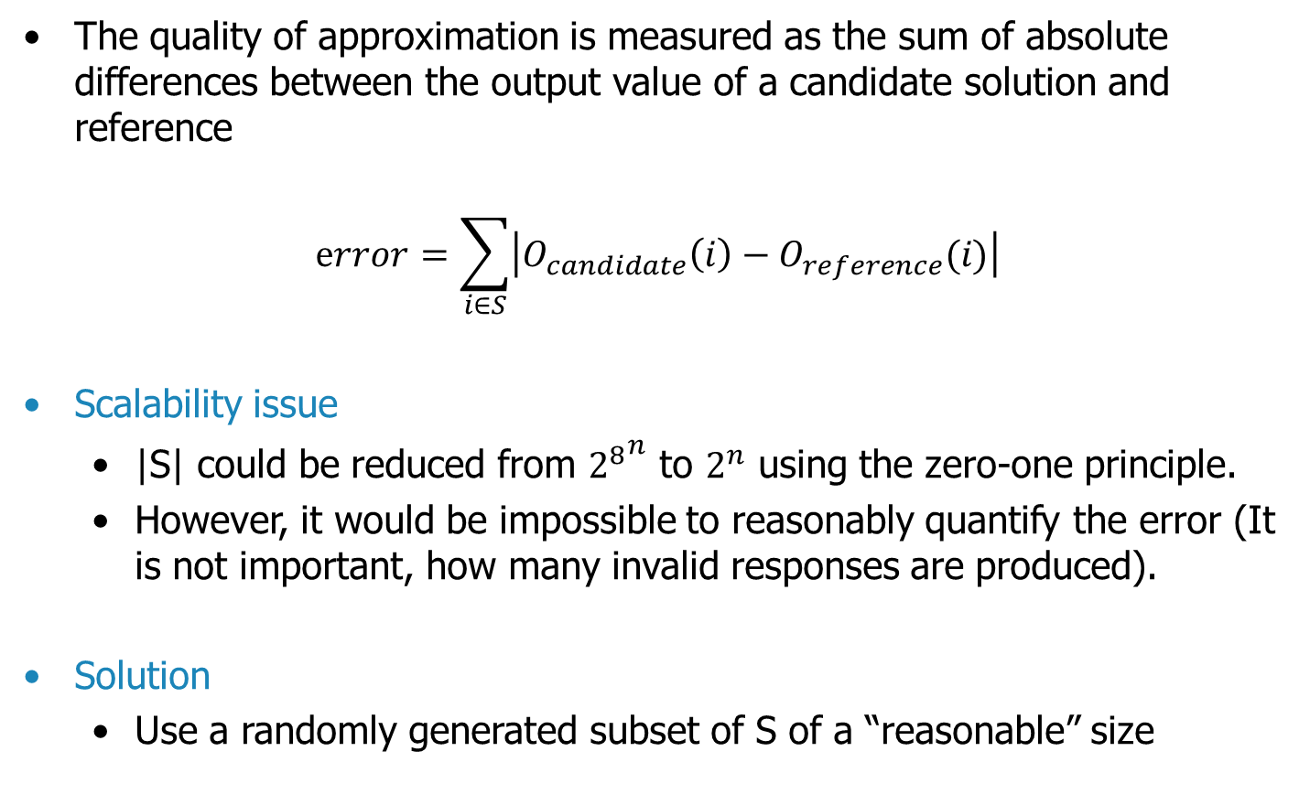
The fitness function
The quality of approximation is measured as the sum of absolute differences between the output value of a candidate solution and reference
$$error=\sum_{i∈S}{\left|O_{candidate}\left(i\right)−O_{reference}(i)\right|}$$
Scalability issue
  |S| could be reduced from ${2^{8}}^{n}$ to $2^{n}$ using the zero-one principle.
  However, it would be impossible to reasonably quantify the error (It is not important, how many invalid responses are produced).
Solution
  Use a randomly generated subset of S of a “reasonable” size
Z. Vasicek and L. Sekanina. Evolutionary approach to approximate digital circuits design. IEEE trans. on Evolutionary Computation, Vol. 19 , No. 3, 2015

Slide 11
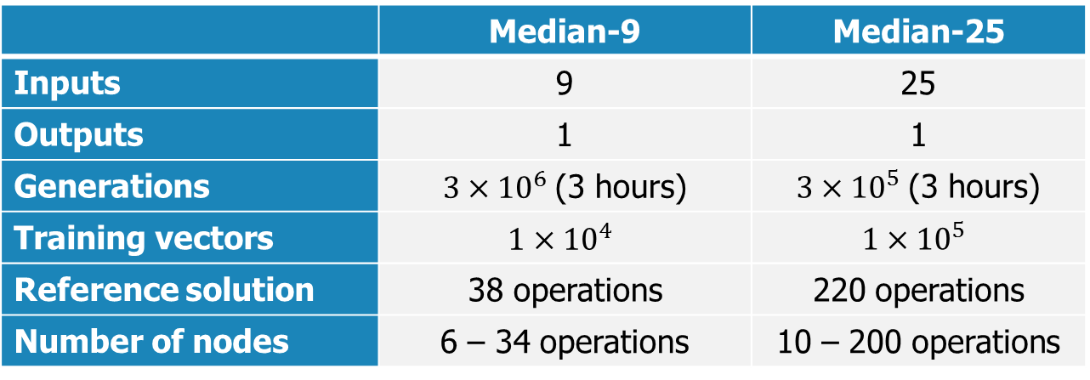
Evolutionary design of approximate medians
Resource-oriented design approach is employed.
  The evolutionary approximation exploits the idea that CGP is capable of minimizing the error even if the number of available functional nodes is not sufficient for obtaining a fully functional solution.
Experimental setup:
  (1+4)-ES, no crossover, 5 % of the chromosome mutated
 | Median-9 | Median-25
Inputs | 9 | 25
Outputs | 1 | 1
Generations | ${3×10}^{6}$(3 hours) | ${3×10}^{5}$(3 hours)
Training vectors | $${1×10}^{4}$$ | $${1×10}^{5}$$
Reference solution | 38 operations | 220 operations
Number of nodes | 6 – 34 operations | 10 – 200 operations

Slide 12
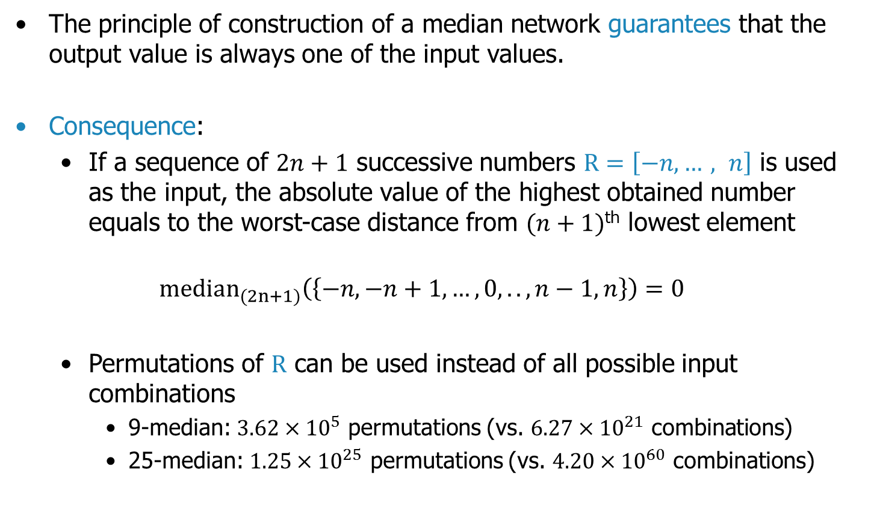
Quality of the evolved approximations
The principle of construction of a median network guarantees that the output value is always one of the input values.
Consequence:
  If a sequence of $2n+1$ successive numbers $R=\left[−n,…, n\right]$ is used as the input, the absolute value of the highest obtained number equals to the worst-case distance from $(n+1)$^{th} lowest element
  $${median}_{(2n+1)}\left(\left\{−n,−n+1,…,0,..,n−1,n\right\}\right)=0$$
  Permutations of $R$ can be used instead of all possible input combinations
    9-median: ${3.62×10}^{5}$ permutations (vs. ${6.27×10}^{21}$ combinations)
    25-median: ${1.25×10}^{25}$ permutations (vs. ${4.20×10}^{60}$ combinations)
Notes:
Zjistit, proc dava tak dobre vysledky I kdyz odstranime pomerne znacne mnozstvi uzlu

Slide 13
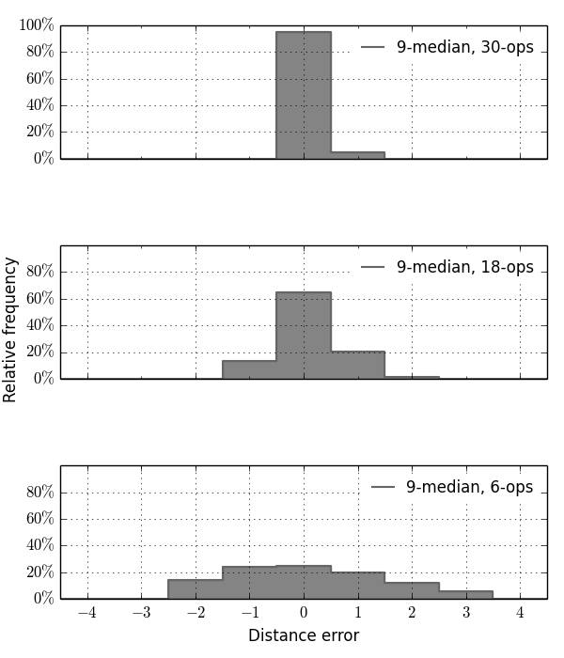
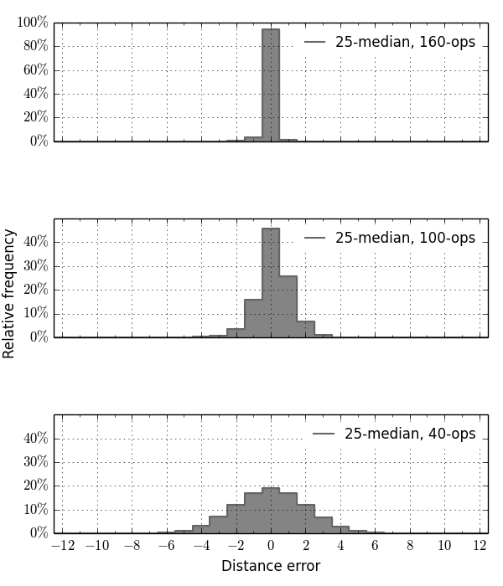
Quality of some evolved approximations
9-input median
fully-working: 38 operations
25-input median
fully-working: 220 operations
21% reduction
27% reduction
95.2%
94.4%
4.8%
52% reduction
54% reduction
45.9%
65.1%
13.4%
20.2%
1.2%
84% reduction
81% reduction
24.6%
19.0%
14.3%
23.8%
19.4%
12.3%
5.5%
Notes:
18 je velmi kvalitni aproximace, ma sice max. chybu 2, ale ta se projevi v mene nez 1.2% pripadu
ERROR PROBABILITY

Slide 14
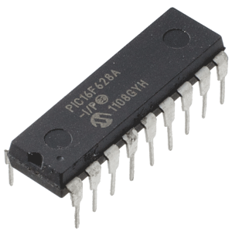


Evaluation of power consumption
Target platforms:
Microchip PIC16F628
  8 bit microprocessor
  accumulator architecture
Microchip PIC24F08
  16 bit microprocessor
  register architecture
ST STM32F100RB
  32 bit microprocessor
  ARM Cortex M3 core
Power consumption measured on real chips.

Slide 15
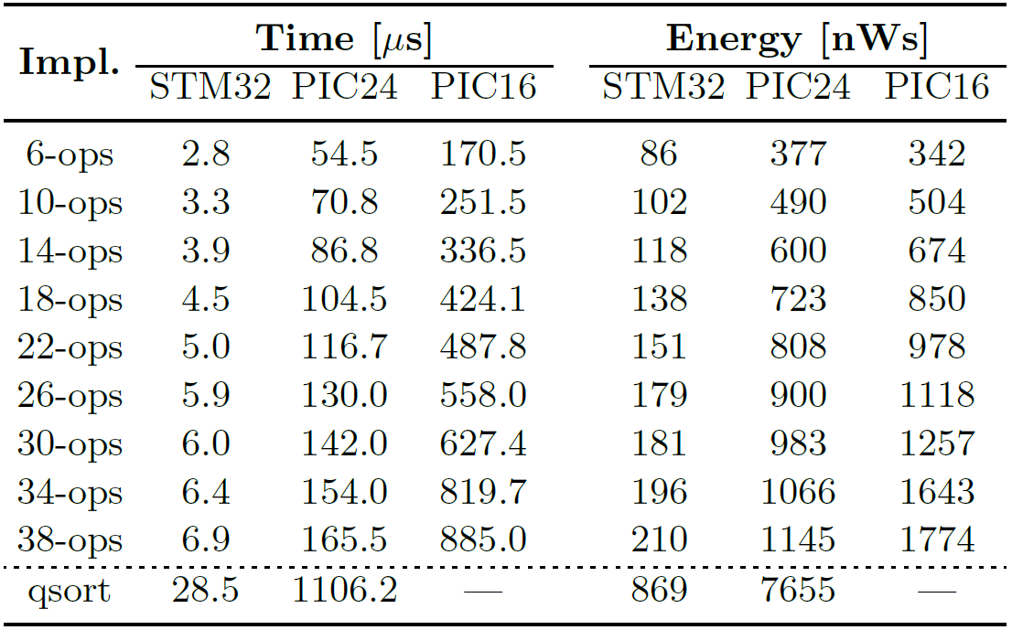
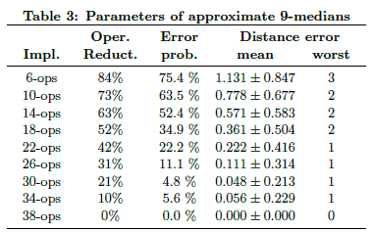
Execution time and power consumption 9-median
34.9% error prob.,
max. error dist. 2
52% power reduction
4.8% error prob.,
max. error dist. 1
21% power reduction
fully-working median
Quick-sort based implementation is slower and consumes significantly more energy compared to the median network.
Due to the limited resources, quick-sort can’t be even implemented on PIC16.
21% reduction in power consumption was achieved in the case of 30-ops median providing a negligible error

Slide 16
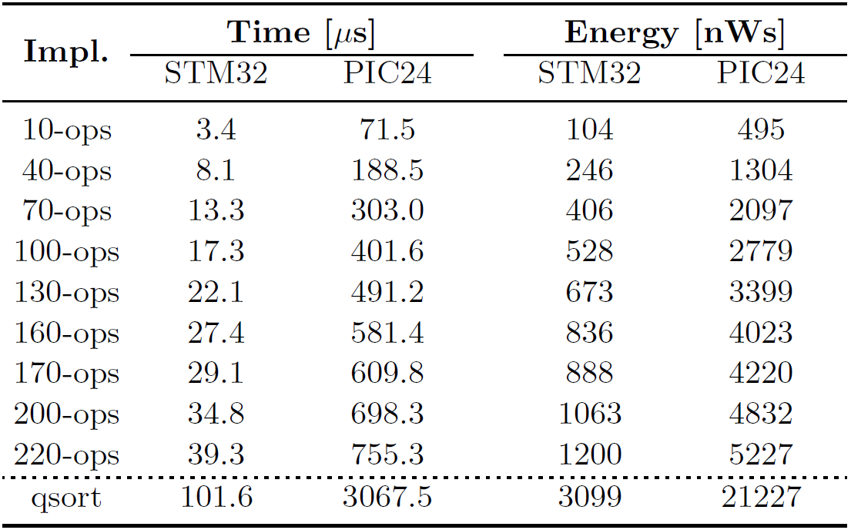
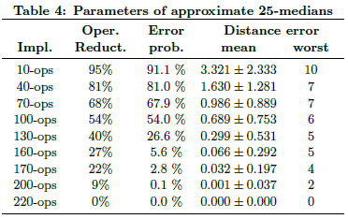
Execution time and power consumption 25-median
25-input median consisting of up to 220 operations offers a higher potential for power savings.
There is nearly linear dependency between the number of operations and consumed energy (approx. 5 nW per operation for STM32).
PIC24 requires five times more energy to accomplish the same operation.

Slide 17
Conclusions
A new approach to the approximation of software routines for MCUs was presented.
We confirmed that CGP is able to find a good trade off between error and code size even if the code size is intentionally constrained.
A significant improvement in power consumption, code size and time of execution was achieved.
A new method for analysis of quality of the proposed approximations was proposed.

